Slide 1

Identification of Technical Skills within Job Descriptions
Group 1: Elliot Bremmer, John DiSessa, Suleman Asif, Kartikey Dubey
ALY 6980 | Capstone
College of Professional Studies | Northeastern University

Slide 2
Table of Contents
Executive Summary (3)
Overview (4)
Dataset Preprocessing & Exploratory Data Analysis (5)
Failed Methodology: Naïve Bayes Model (6)
Successful Methodology: Natural Language Processing (7)
Demonstrated Examples
Skills for all jobs in dataset (8)
Skills for job-specific subset (9)
Recommendations (10)
Lessons Learned, Key Takeaways, & Conclusion (11)

Slide 3

Executive Summary
Business Objective
Identify the most prevalent skills found in entry-level jobs in order to recommend curriculum changes to universities to better prepare students
Building a Model
Build a model that is easily replicable and can be continue to be used as industries and jobs change over time
Soft Skills vs Technical Skills
Soft skills, such as communication and visualization, are common across all types of jobs
Technical skills, like Python, vary in accordance with the type of job

Slide 4



Overview of the Business Problem & Dataset
BUSINESS PROBLEM
Distinguish several skills sets required for the Job and recommend the skills to the Colleges to adapt or change their curriculums basis on the job market.
Create several EDAs to extract the key job skills and create several models to accurately predict the futures patterns/requirements based on the identified skill sets.
Validate the various models and deploy the best suited model for decision making of Job requirements in the market.
DATASET
The dataset obtained has 10,201 entries and comprises 4 attributes:
Job URL
SIP Code
Job Title
Job Description

Slide 5
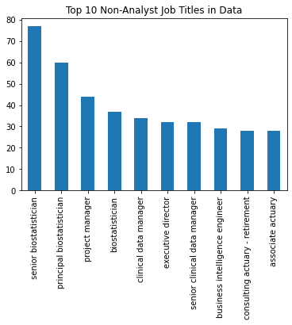
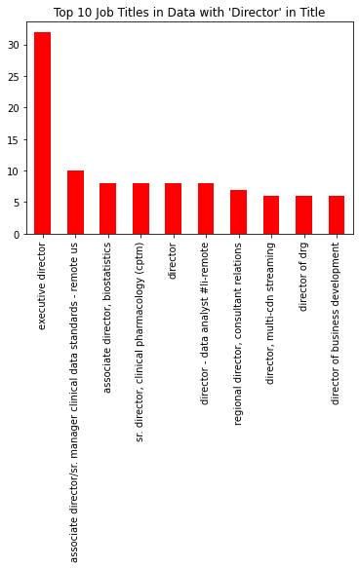
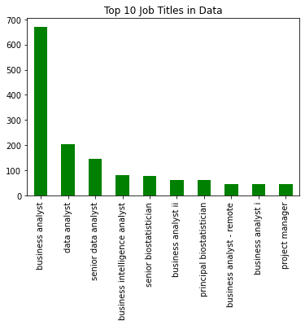
Data Preprocessing & Exploratory Data Analysis
Data Cleaning
Basic data cleaning: nulls, white spaces, data structure
Job Titles
All
Non-Analyst
Non-entry level roles

Slide 6
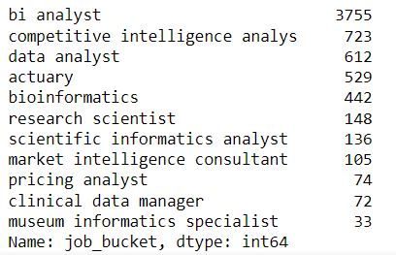
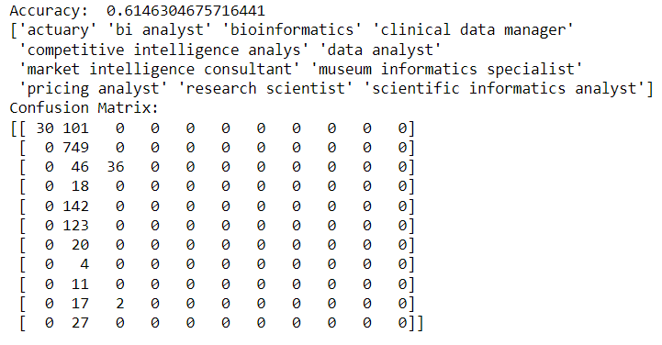
Naïve Bayes Model
Job Categories:
Experimented with several approaches: Word Clouds, Naïve Bayes Classification Model, and Natural Language Processing (NLP) – Part-of-Speech (POS) and Keyword Extraction.
Classification of vectorized job descriptions (X) into job categories (Y) created based on ‘bucketed’ spreadsheet names.
Not very accurate (~61%) – too much noise in the data to produce accurate result.
Model Accuracy

Slide 7
Natural Language Processing
Experimented with several approaches: Word Clouds, Naïve Bayes Classification Model, and Natural Language Processing (NLP) – Part-of-Speech (POS) and Keyword Extraction.
Required additional preprocessing - removal of stopwords & lemmatization.
Required qualitative research to create a comprehensive list of keywords.
Technical Skills: Programming Languages, Technologies, Analytics, etc.
Soft Skills: Communication, Presentation, Interpersonal, etc.
Applied to two distinct usecases: Wholistic and Job-Specific Subset.

Slide 8
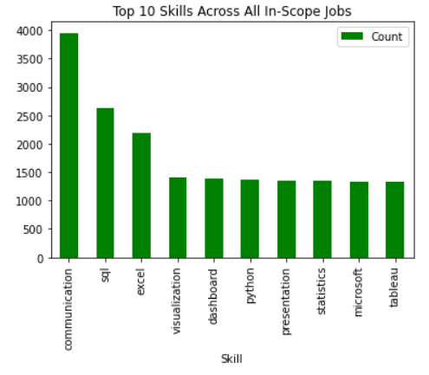
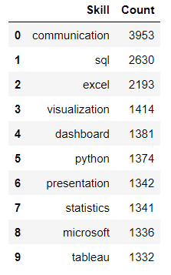
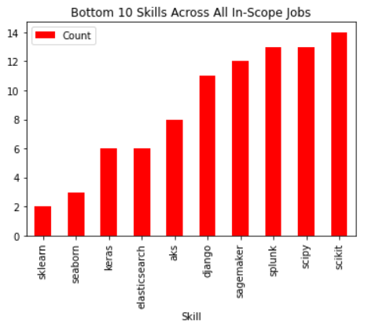
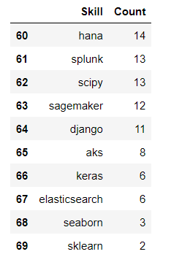
Usecase #1: Technical Skills for all Jobs
Mix of soft skills, basic technical knowledge, and data visualization.
Strong communication and presentation skills are highly desirable by employers.
Less desirable skills are largely programming packages/frameworks or very specific technologies.
Expected outcome based on keyword list.

Slide 9
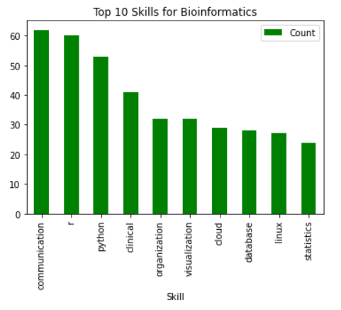
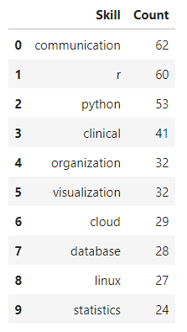
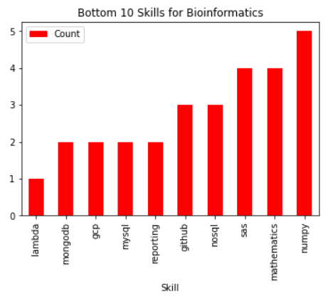
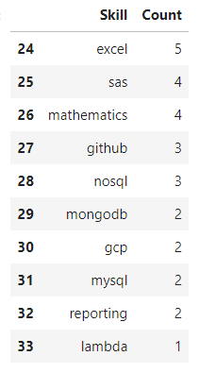
Usecase #2: Technical Skills for a Subset
Bioinformatics-only Positions
Beneficial for Academic Advisors
Similarities
Communication
Visualization
Python
Statistics
Differences
Excel
GitHub
Clinical

Slide 10

Recommendations for the Sponsor
Job-Specific Use Cases
Skills vary between job categories
Alternative Approach
Skills First
Time Trends
Keep up with fast-changing industries
Additional Data
Recruiting Relationships
Internal Job Board
Entry-level Jobs
Bioinformatics Jobs

Slide 11
Key Takeaways & Conclusion
Experience working on a real-world problem beyond the scope of our respective day-to-day jobs and/or schoolwork.
Experience applying some of the skills we learned throughout our studies.
Fail fast but fail forward. Learn from mistakes and be adaptable.

Slide 12
References
POS (Part-Of-Speech) Tagging & Chunking with NLTK. (2019, June 11). Guru99.com. https://www.guru99.com/pos-tagging-chunking-nltk.html
Justin, L. &. (2020, February 28). How to use NLP in Python: a Practical Step-by-Step Example. Just into Data. https://www.justintodata.com/use-nlp-in-python-practical-step-by-step-example/
Li, S. (2018, September 25). Multi-Class Text Classification Model Comparison and Selection. Towards Data Science; Towards Data Science. https://towardsdatascience.com/multi-class-text-classification-model-comparison-and-selection-5eb066197568
Team, Z. R. M. R. (n.d.). Must-have skills list & keywords for your resume. ZipRecruiter. Retrieved March 19, 2023, from https://www.ziprecruiter.com/career/Resume-Keywords-and-Skills
Indeed.com - indeed career guide. (n.d.). Retrieved March 19, 2023, from https://www.indeed.com/career-advice/resumes-cover-letters/skills
Linkedin free vector icons designed by Freepik. (n.d.). Flaticon. https://www.flaticon.com/free-icon/linkedin_174857
‌Corporation, S. (n.d.). CSM - Career Services Manager | Symplicity. Www.symplicity.com. Retrieved March 31, 2023, from https://www.symplicity.com/higher-ed/solutions/csm

